Slide 1

Design Presentation
SoundScape
Austin Schoster, Joe Schnizer, Derrick Mchale

Slide 2

Project Abstract
Our project is an AI-powered music app that generates personalized playlists by integrating with the Spotify API. The app tailors music recommendations to each user’s preferences by analyzing various factors such as listening history, current mood, location, weather, time of day, and connected devices like cars or speakers. What’s unique about this app is how personalized the playlists will be that it creates. It lets users control how much new music they want to discover, blending familiar tracks with fresh selections and accounting for the right mood or timing that may influence what someone wants to hear. This app will aim to create a seamless listening experience that evolves with the user’s context and preferences.

Slide 3
Group Members and Advisor
Austin Schoster
schostaj@mail.uc.edu
Joe Schnizer
schnizjt@mail.uc.edu
Derrick Mchale
mchaleds@mail.uc.edu
Will Hawkins
Advisor

Slide 4

Project Purpose and Goals
Purpose
To develop an app that provides personalized and accurate playlists based on various factors and that can provide a playlist with no songs the user wants to skip at any given time
Goals
Development of skills for all group members, particularly in mobile development or AI
To create an app that fulfills the purpose described here
To create an app that we (and potentially others) would use every day
To have fun!

Slide 5
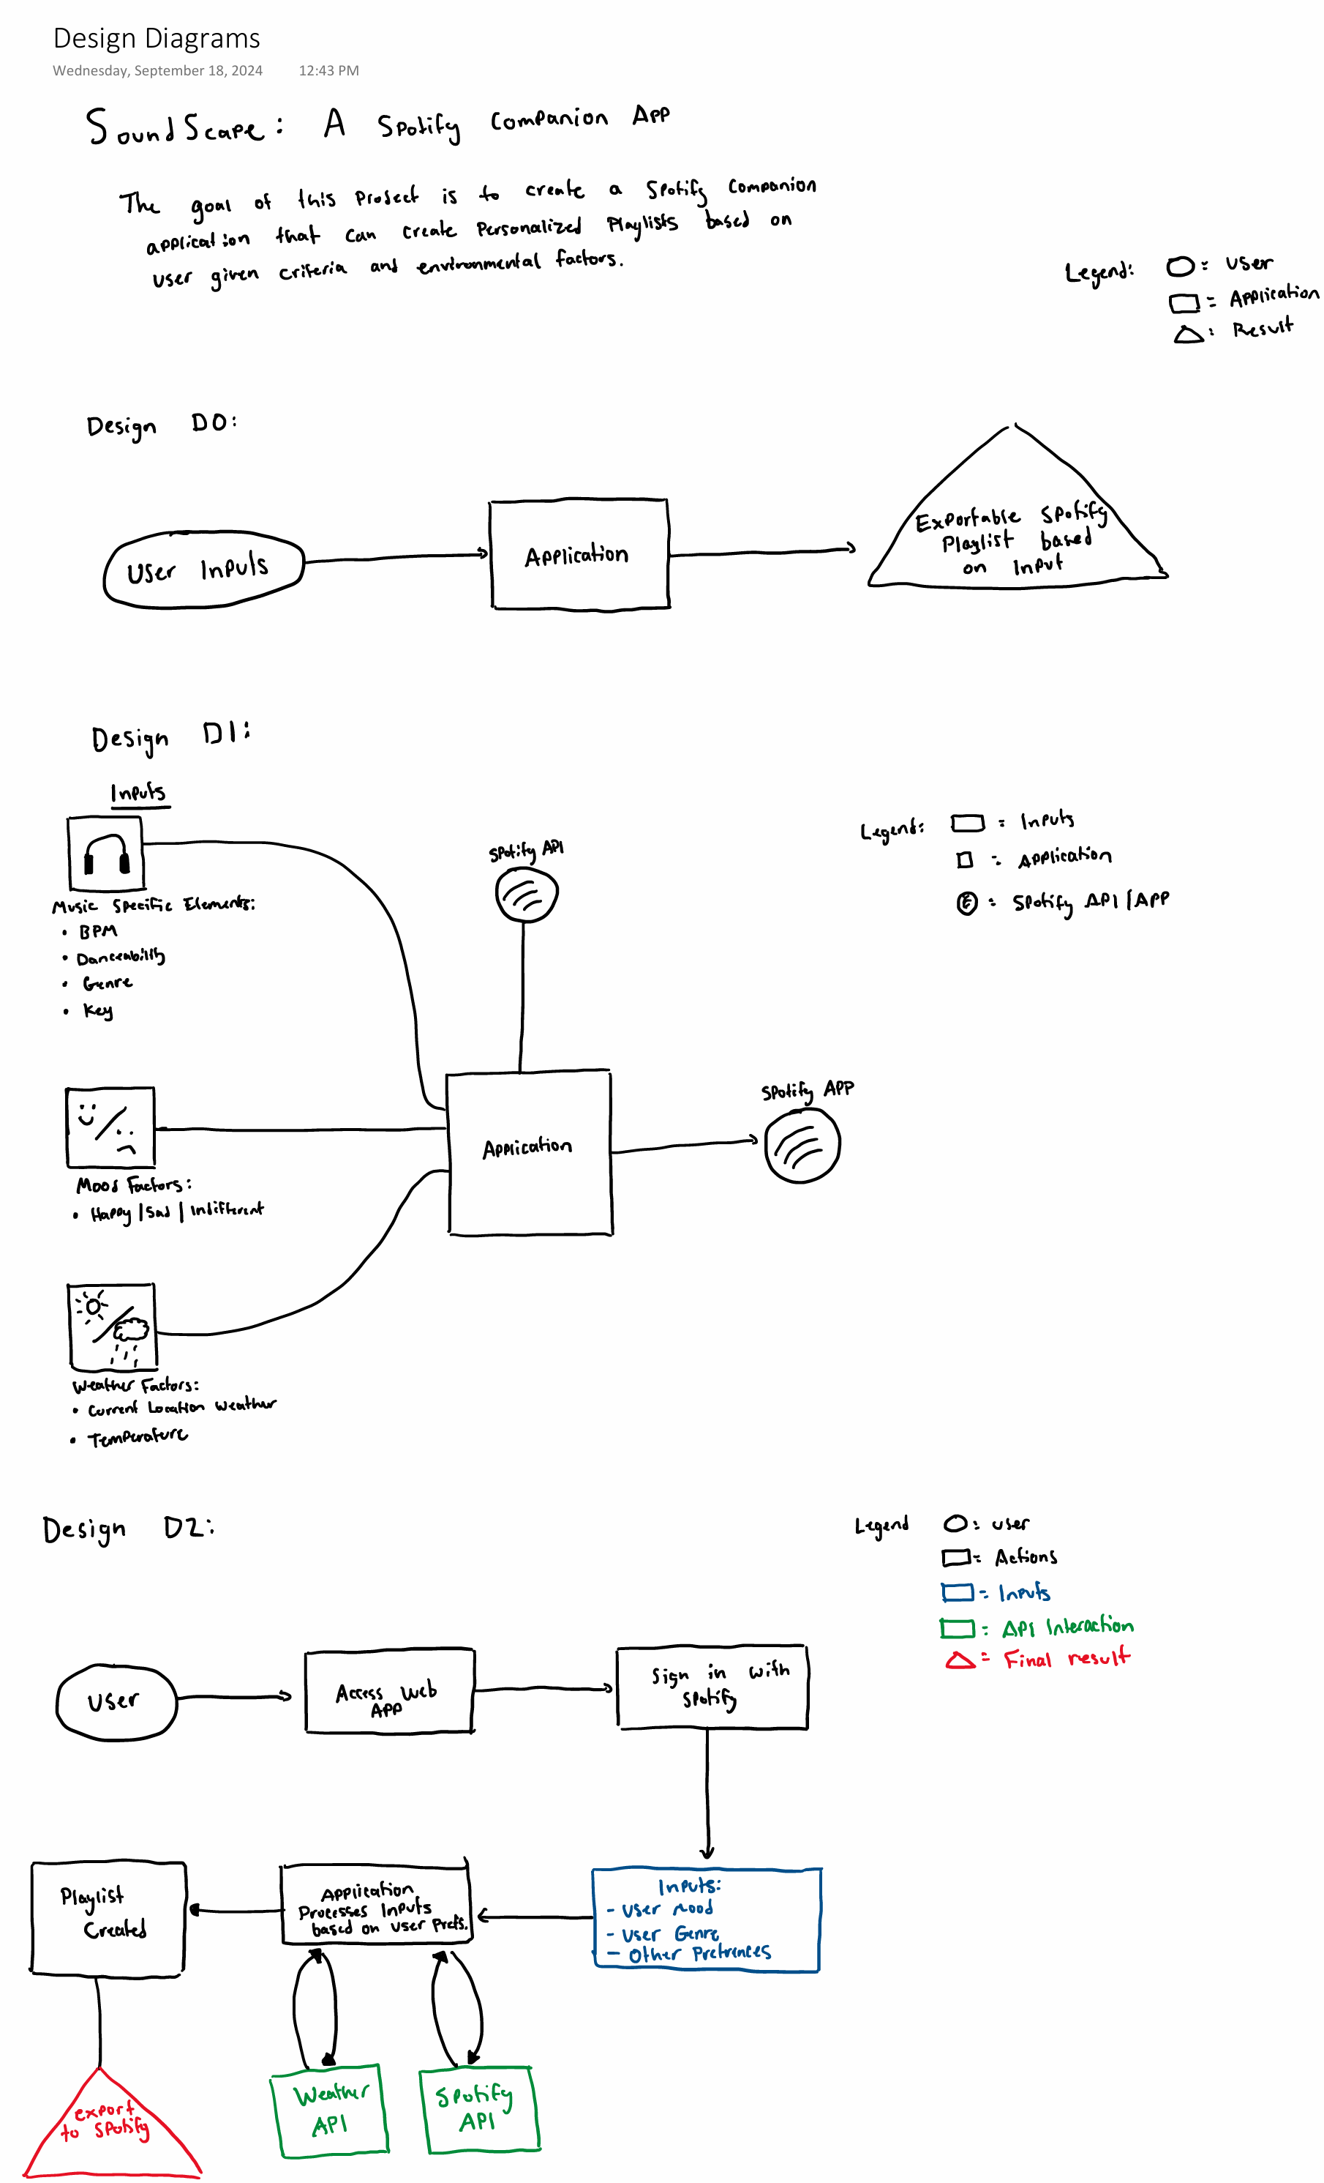
User Stories and Design Diagrams
User Stories
As a runner, I want the ability to quickly create a playlist of high tempo music that fits my tastes in order to keep me energized throughout a run.
As a student using Spotify, I want a playlist with more relaxed music than I typically listen to without too many lyrics to help me focus while I study.
As someone on the move, I want to have a playlist that matches my current mood and interests well so that I don't want to have to regularly skip songs or manually select a song to listen to.
As an avid music listener, I want the ability to easily choose whether I want new music to listen to or music that I already know in order to have a varied listening experience.
Design Diagrams
View on the right

Slide 6
Major Project Constraints
Economics
Project has no budget and required resources may require funding
Ethics/Security
Project will collect potentially sensitive personal data
Professional Expertise
The group does not have experience with developing apps of this nature

Slide 7
Review of Project Progress
The project is still in the initial research and setup phases
Research is being conducted in areas that the group is unfamiliar with but will be needed to develop the app, such as AI
Research is also being conducted to determine the best approach to develop the app

Slide 8
Division of Work
Joe – Responsible for:
Developing a user interface that users can interact with to get their playlists
Researching and investigating Spotify API calls
Researching mobile app development
Developing a unit testing scheme
Developing documentation for the application as the process moves forward
Derrick – Responsible for:
Researching frameworks to develop the application within
Developing an AI model to assist in creation of playlists
Developing the logic to create personalized playlists based on user input
Developing a testing plan for the application
Executing testing of functionality at the end of the project
Austin – Responsible for:
Researching AI usage
Identifying APIs our application will need to utilize
Acquiring Spotify API credentials
Creating a proxy server so that API calls to spotify can be made
Developing code to centralize data collection for use when developing playlists

Slide 9

Expected Accomplishments by End of Term
By the end of this semester, we expect the research/decision making phase of this project to be completed. To accomplish this, we need to have the following things done:
Research on different frameworks to develop within
Research on the AI model we will use within the application
Decide what our focus should be between fully realizing the AI component of the app versus creating a mobile port
Set up a proxy server and make basic API calls
Create a basic outline of the application itself

Slide 10
Expected Demo at Expo
Interactive Demo that users can try on their own
Present devices with web and mobile app versions that can both be demoed
Allow users to log in with their Spotify credentials and then build a playlist to export
The user will then be able to open Spotify on their own device and see that the created playlist has been exported to their device.

